Slide 1
March Run Study
Engineering Run 15

Slide 2
Centroid Repeatilibility

Slide 3
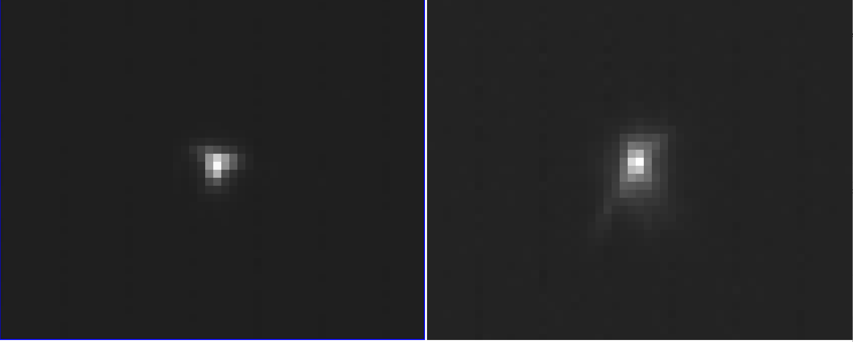
MCS realignment caused the PSF change. Although the overall image qulaity is consistent, the difference in PSF shape impact the centroid algorithm.
2023/July
2023/July

Slide 4
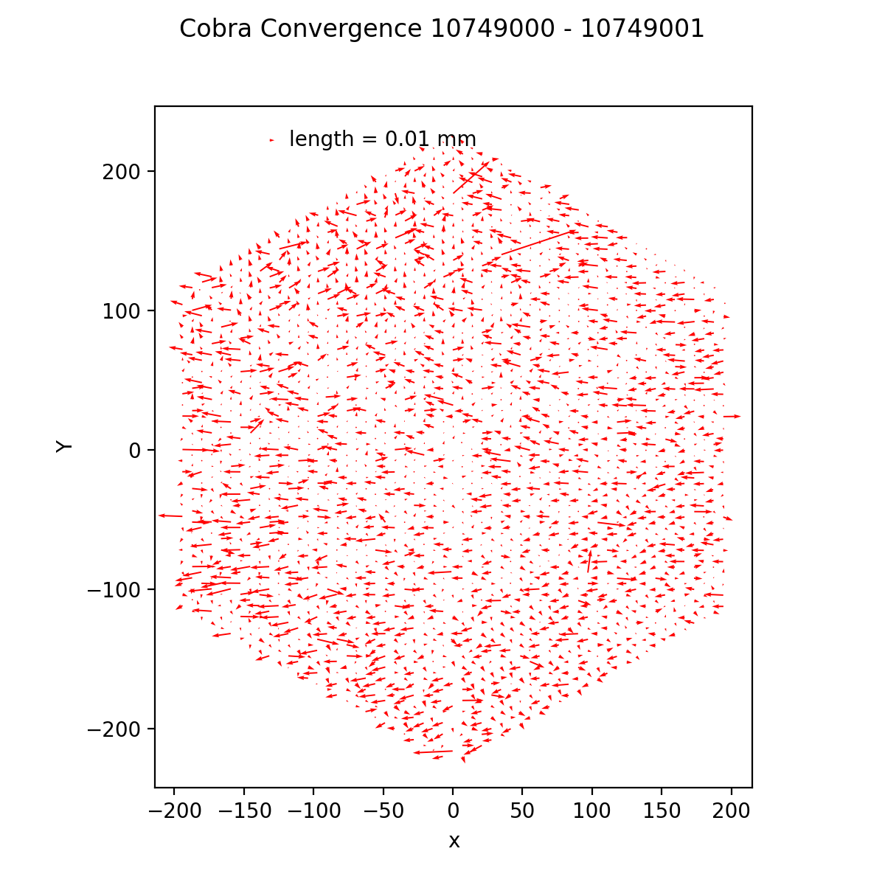
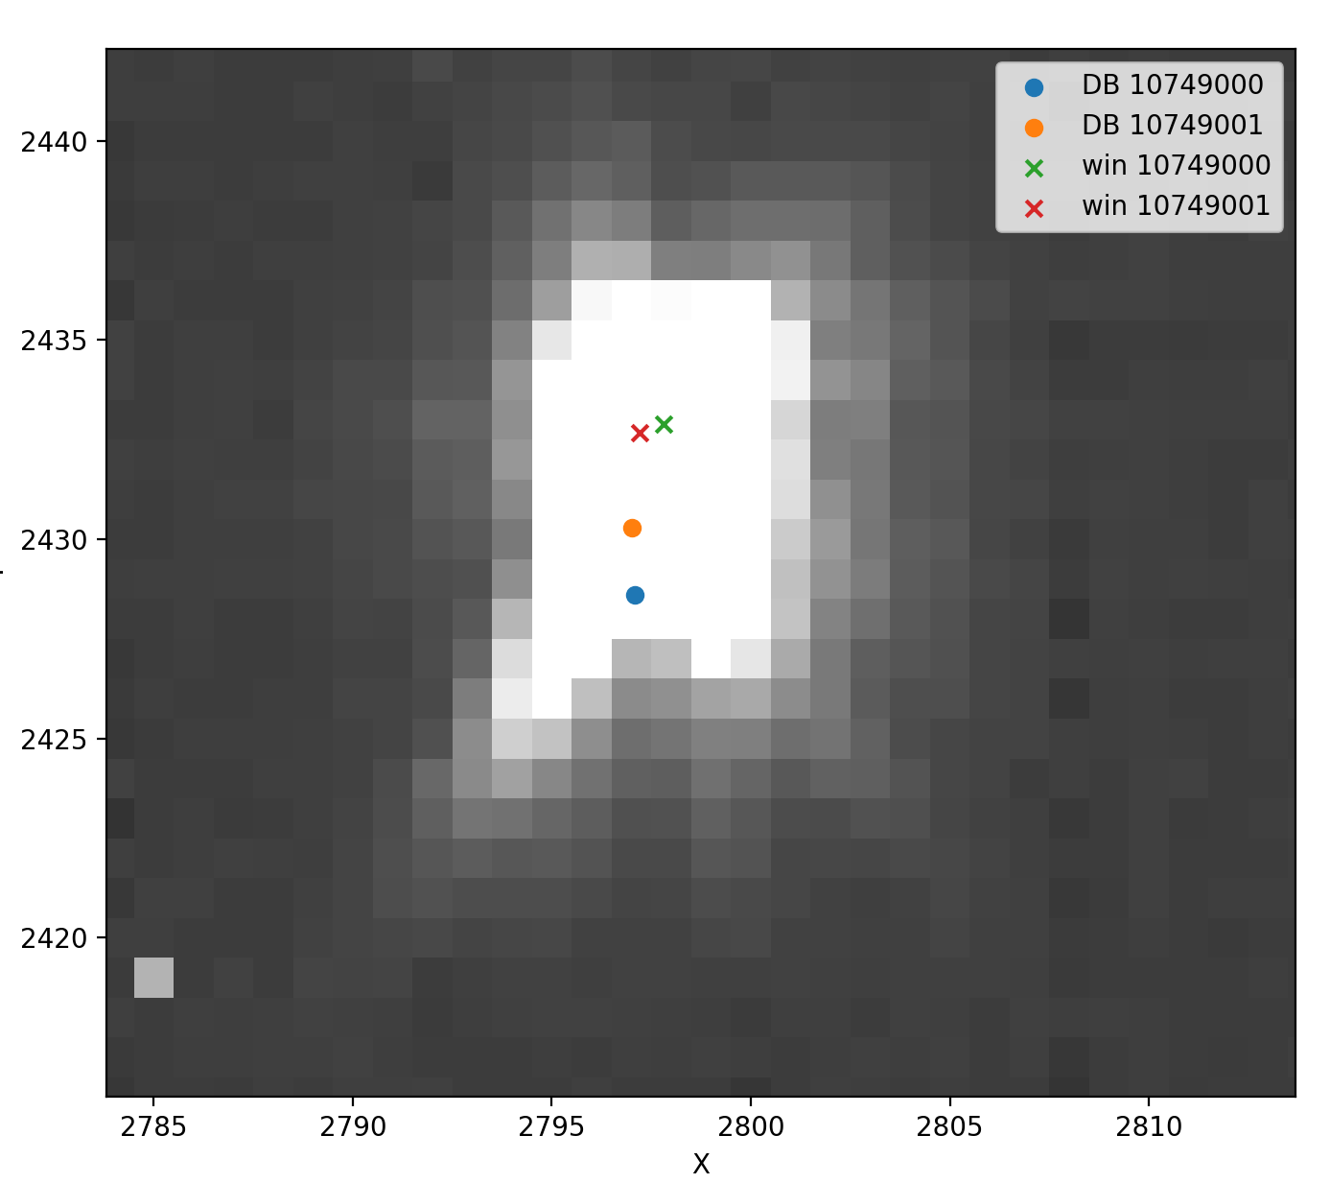
There are two issues related to the centroid code, kernel size and culling method.

Slide 5
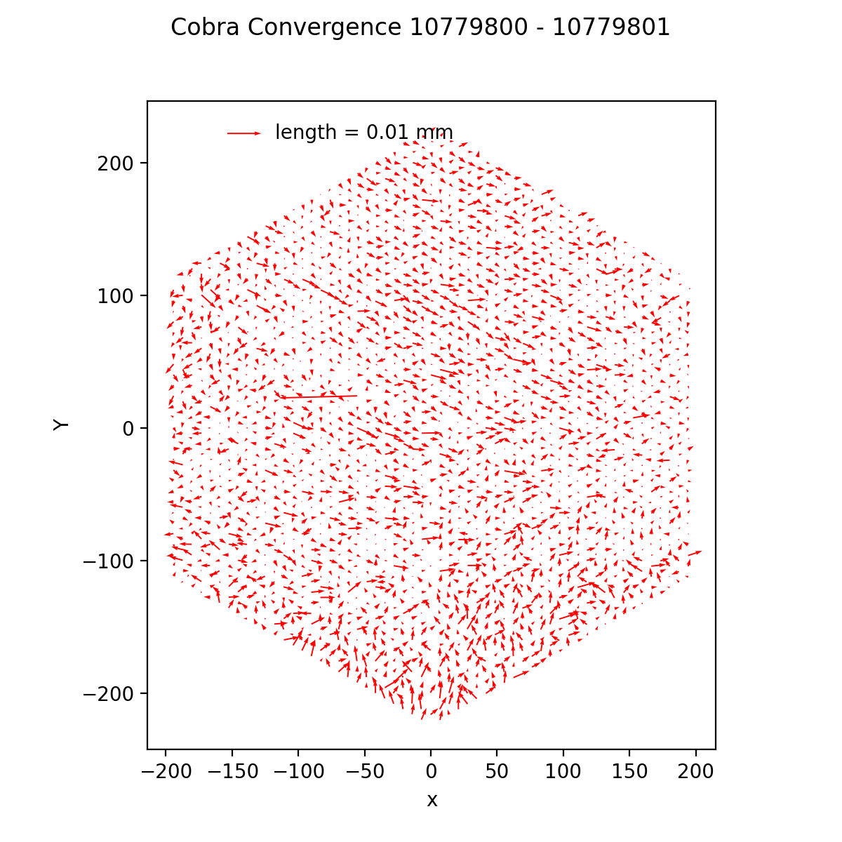
We fisrtly turn off the multi-processing.
Then, we changed the kernel size.
The centroid repeatibility is improved.

Slide 6
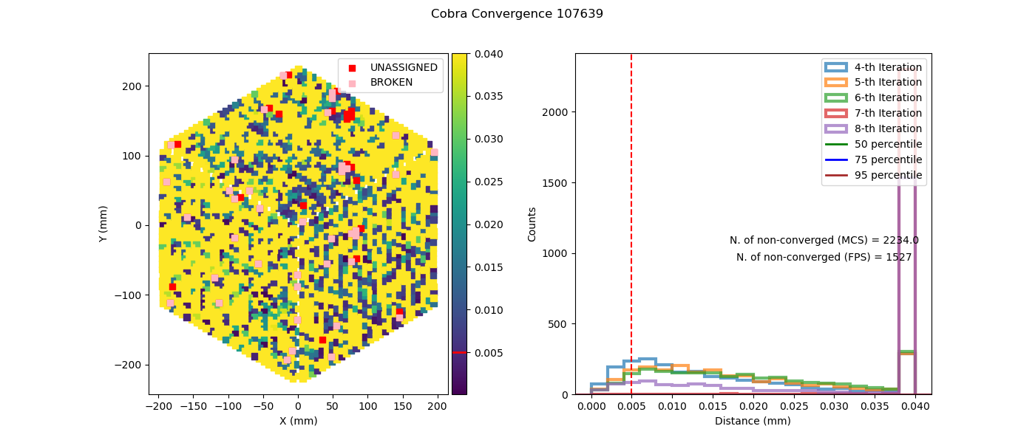
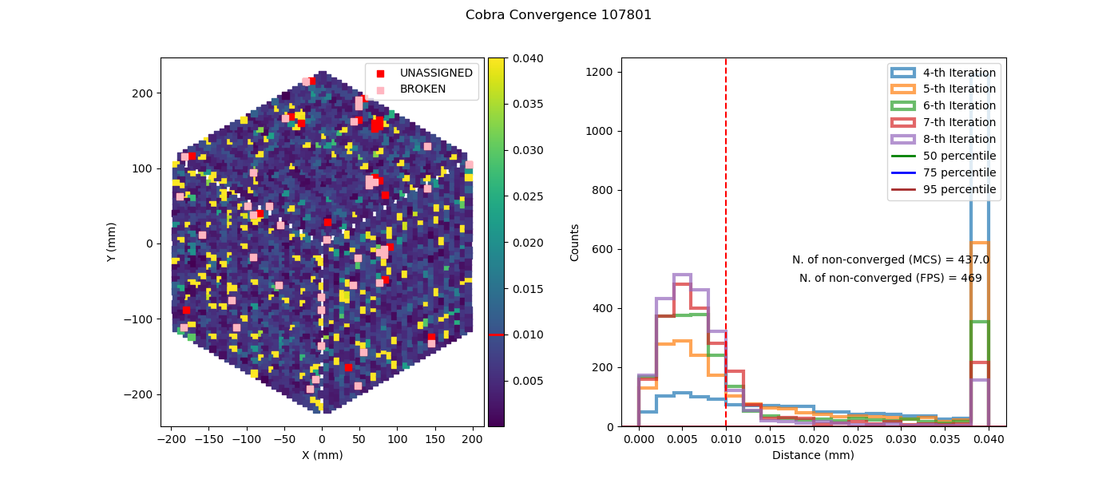
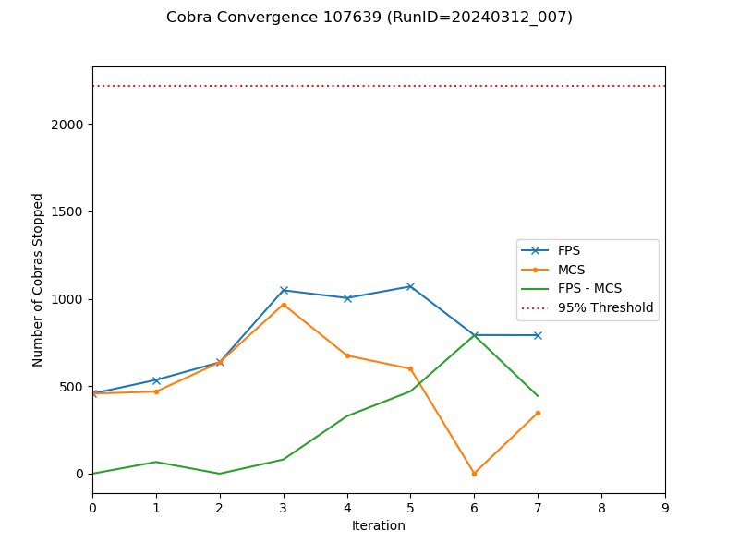
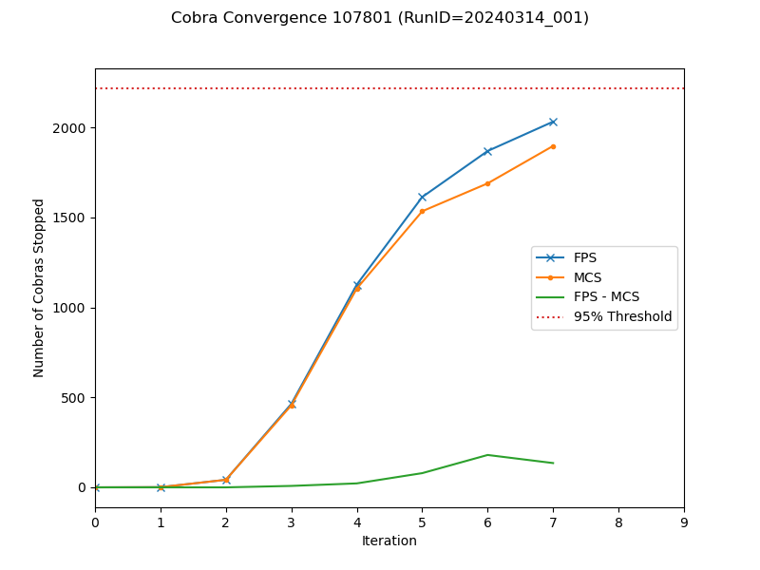
The convergence is improved after the correction with the same design.

Slide 7
Convergence Study

Slide 8
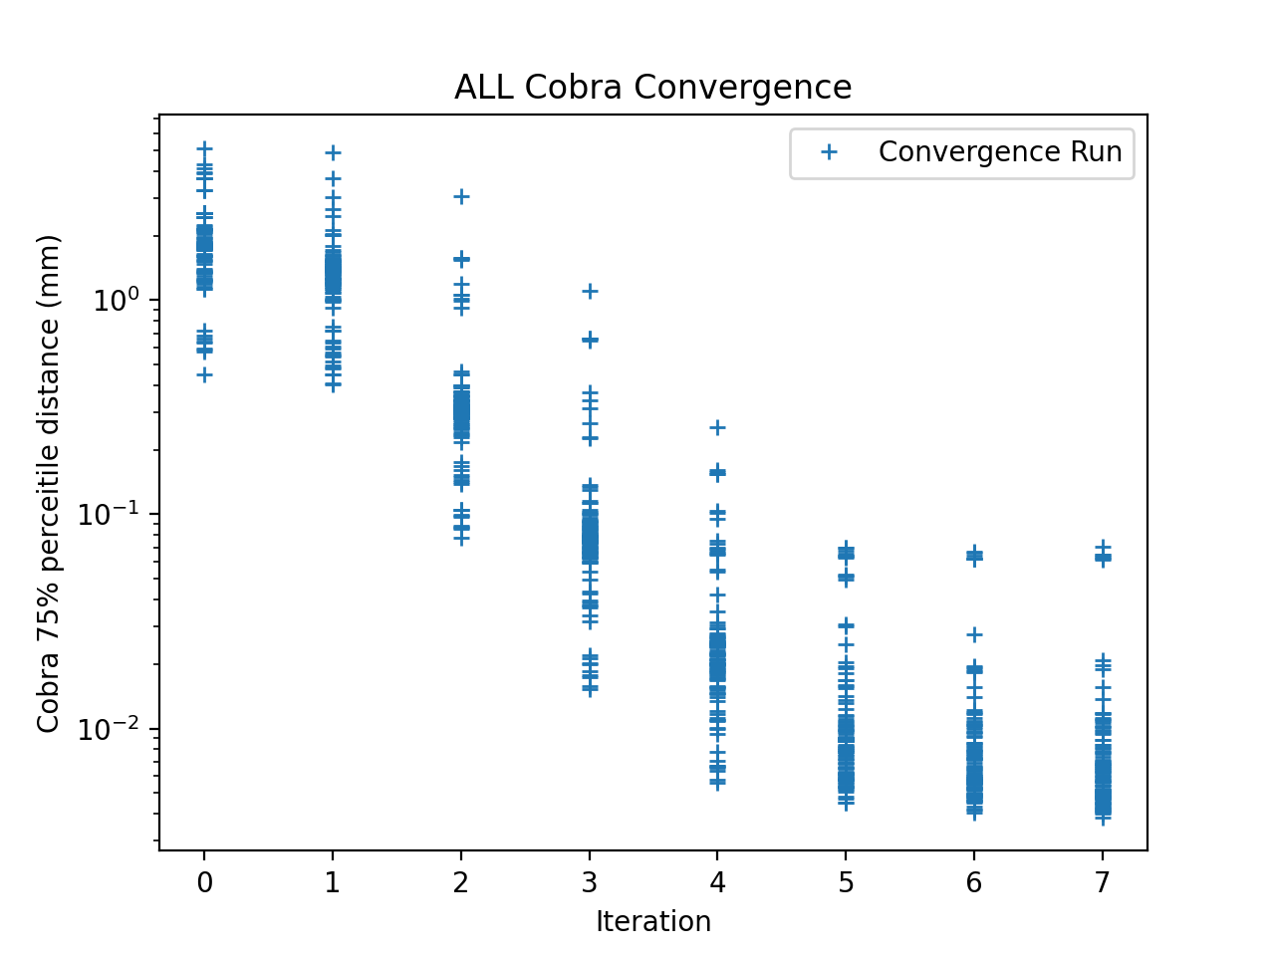
In the eng15 run, we did 164 convergence runs. However, we spend 54 runs on revising cetroid code. Therefore, we have 110 convergence runs.
There are 87 runs with 75% percentile < 0.01mm.

Slide 9
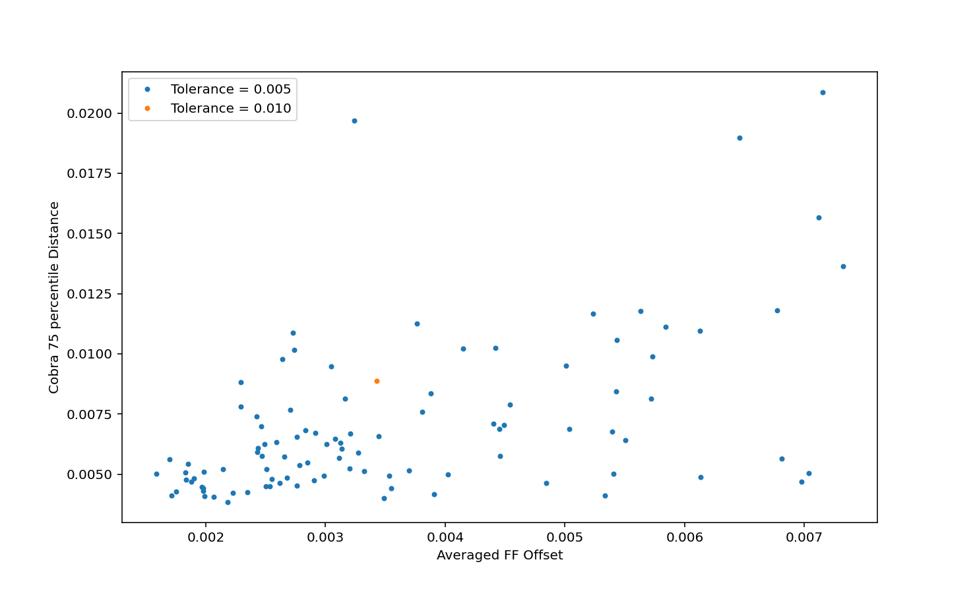

Slide 10
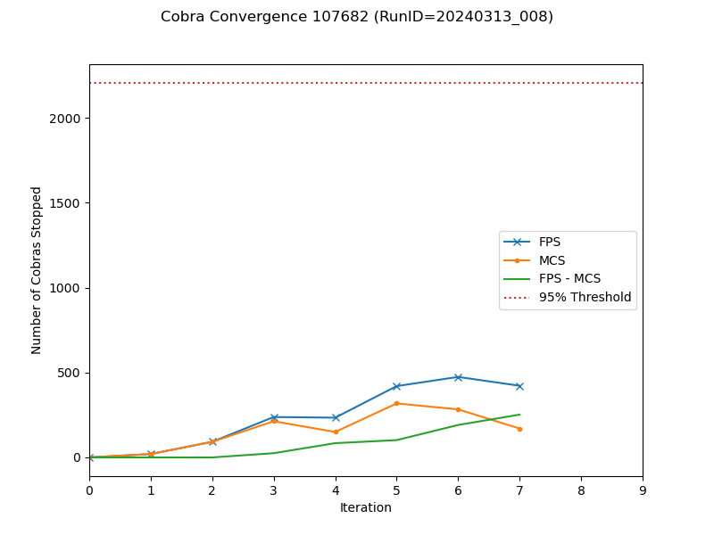
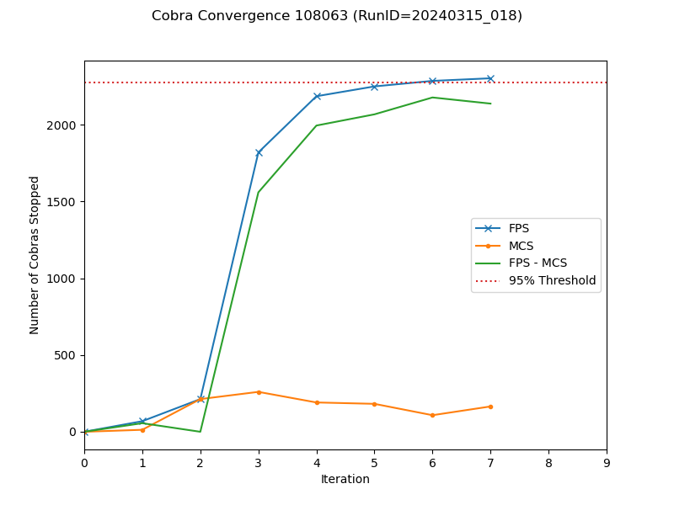
Example of bad convergence run

Slide 11
Cobra Geometry

Slide 12
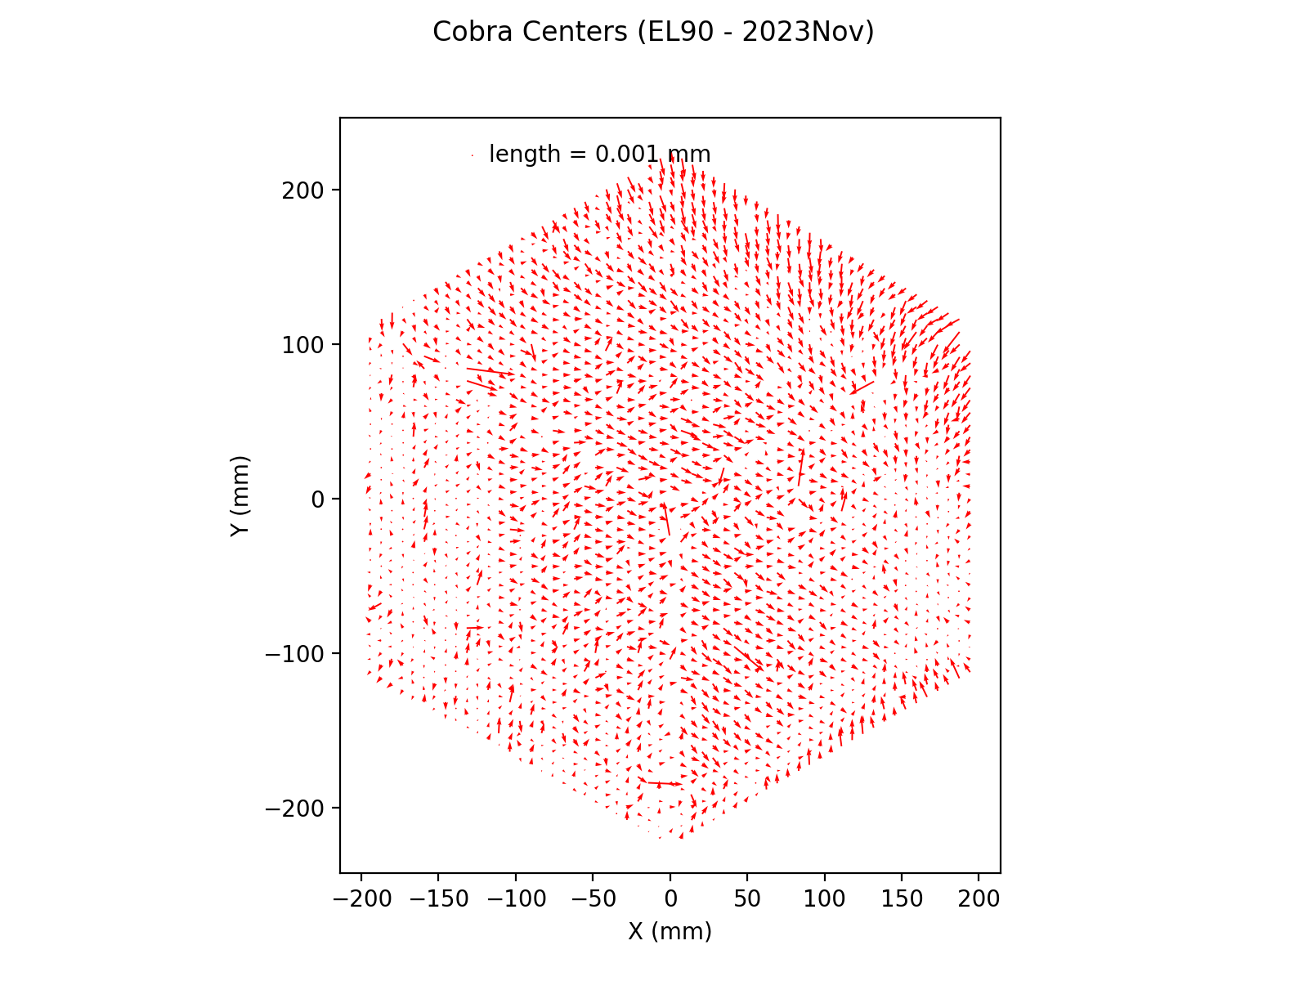
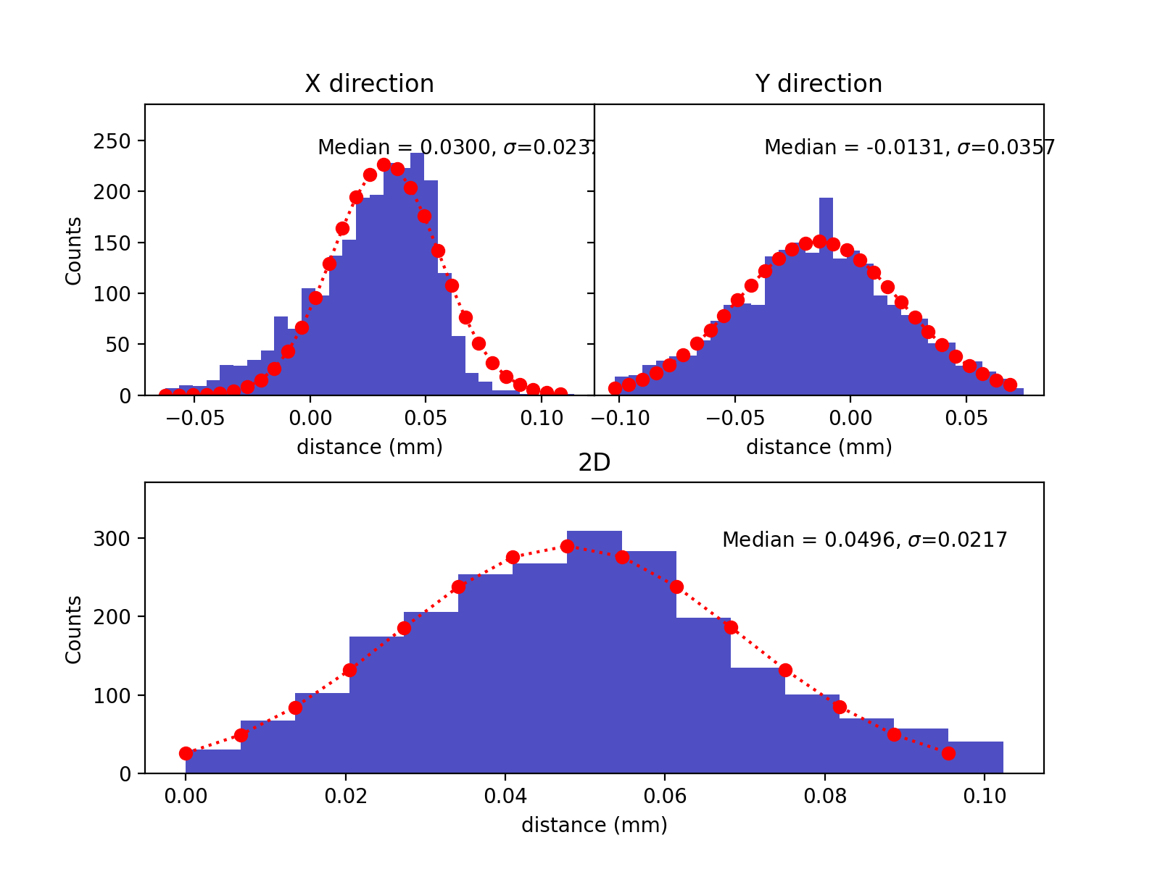
EL90 on 3/14

Slide 13
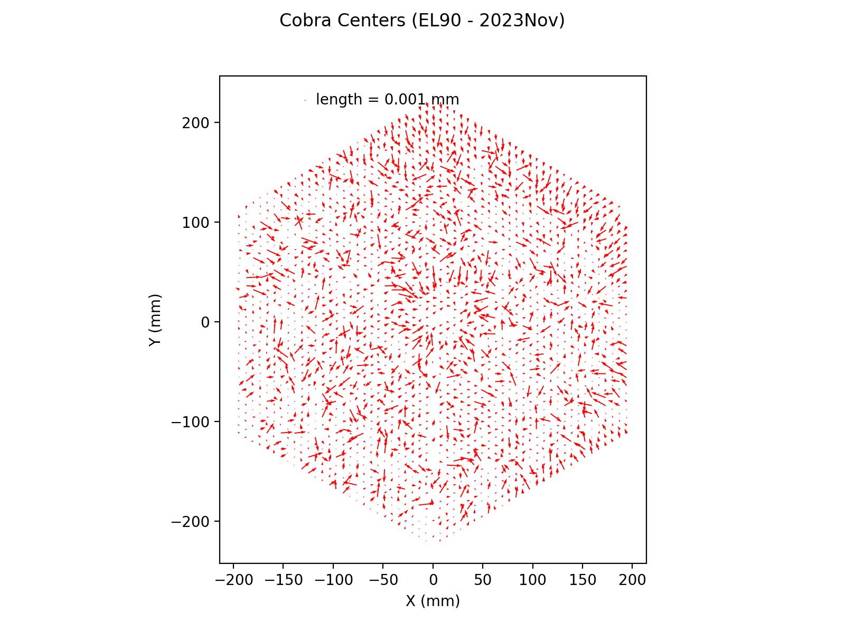
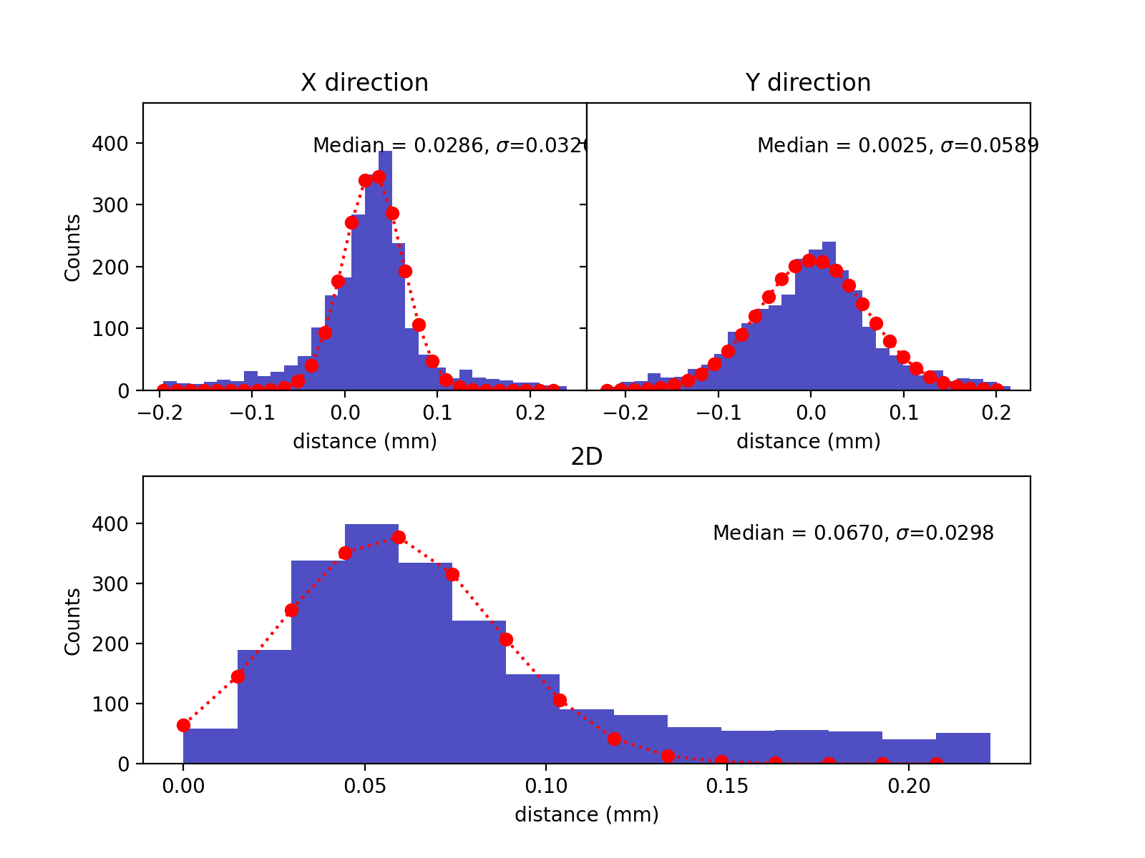
EL90 on 3/16

Slide 14
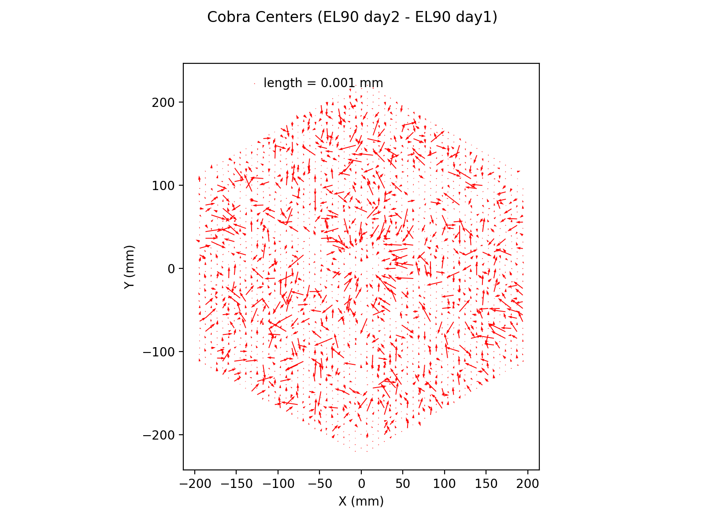
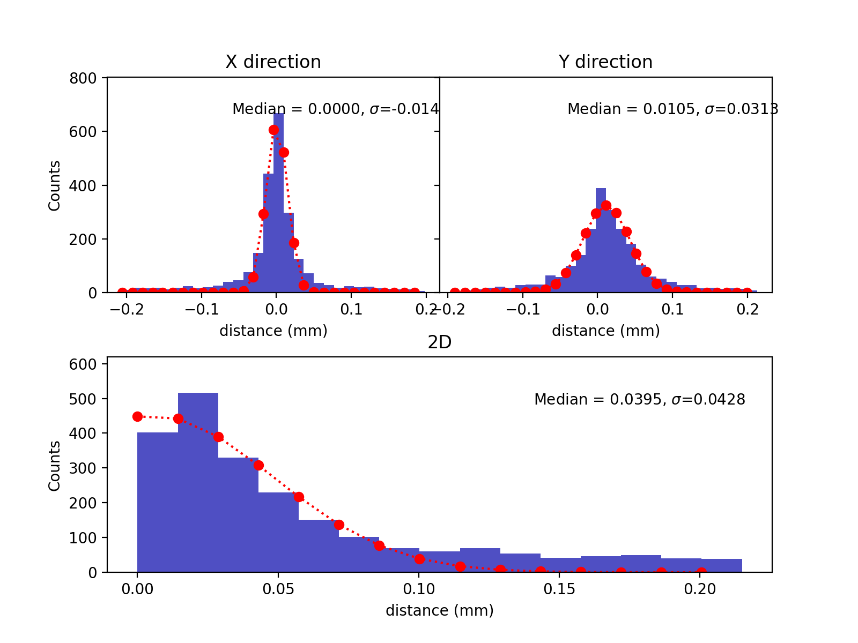

Slide 15
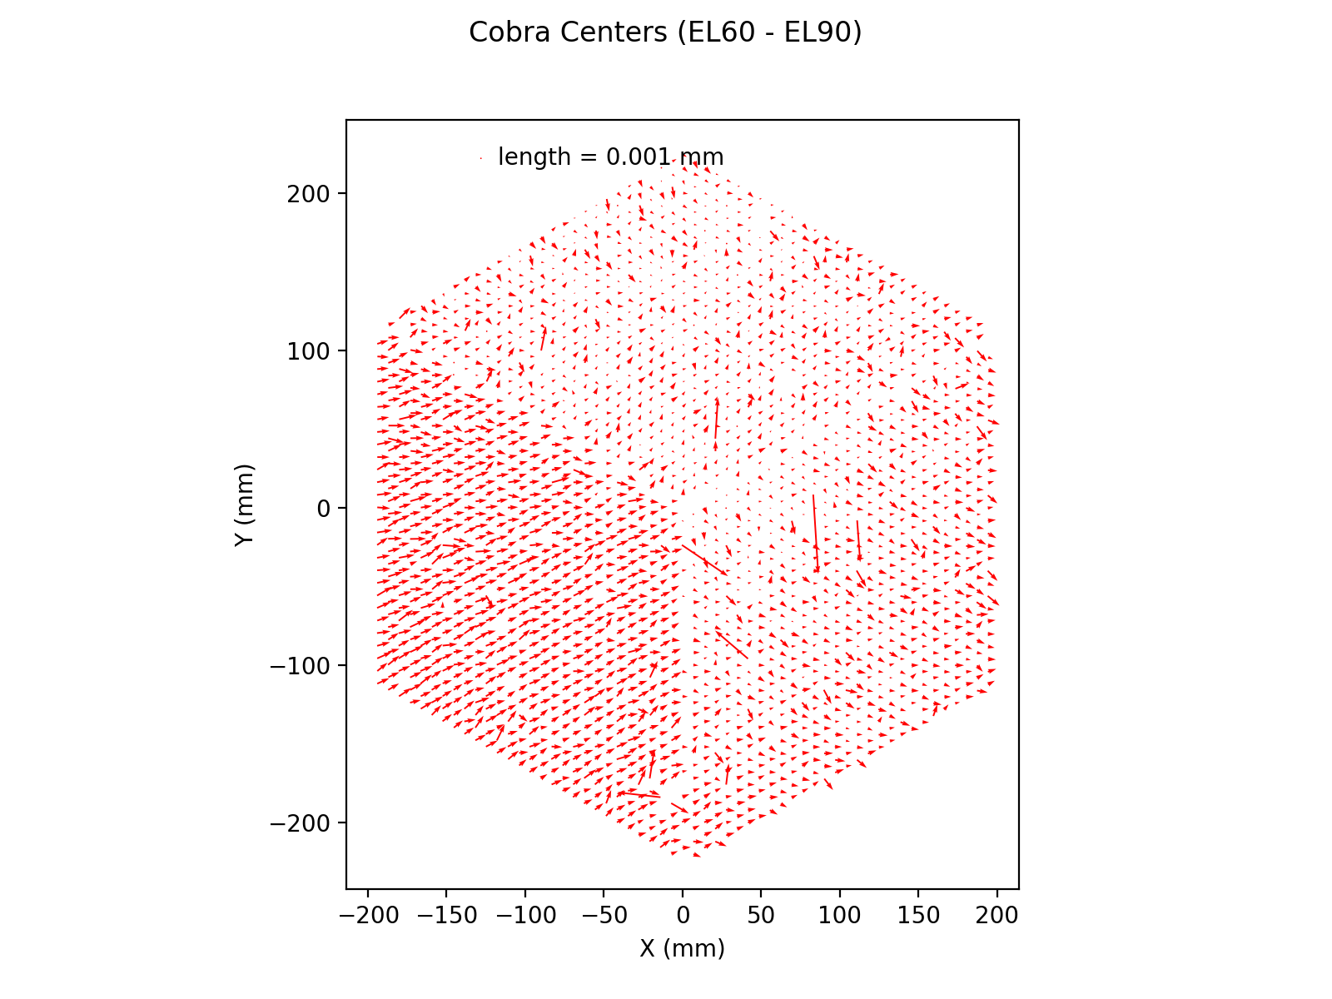
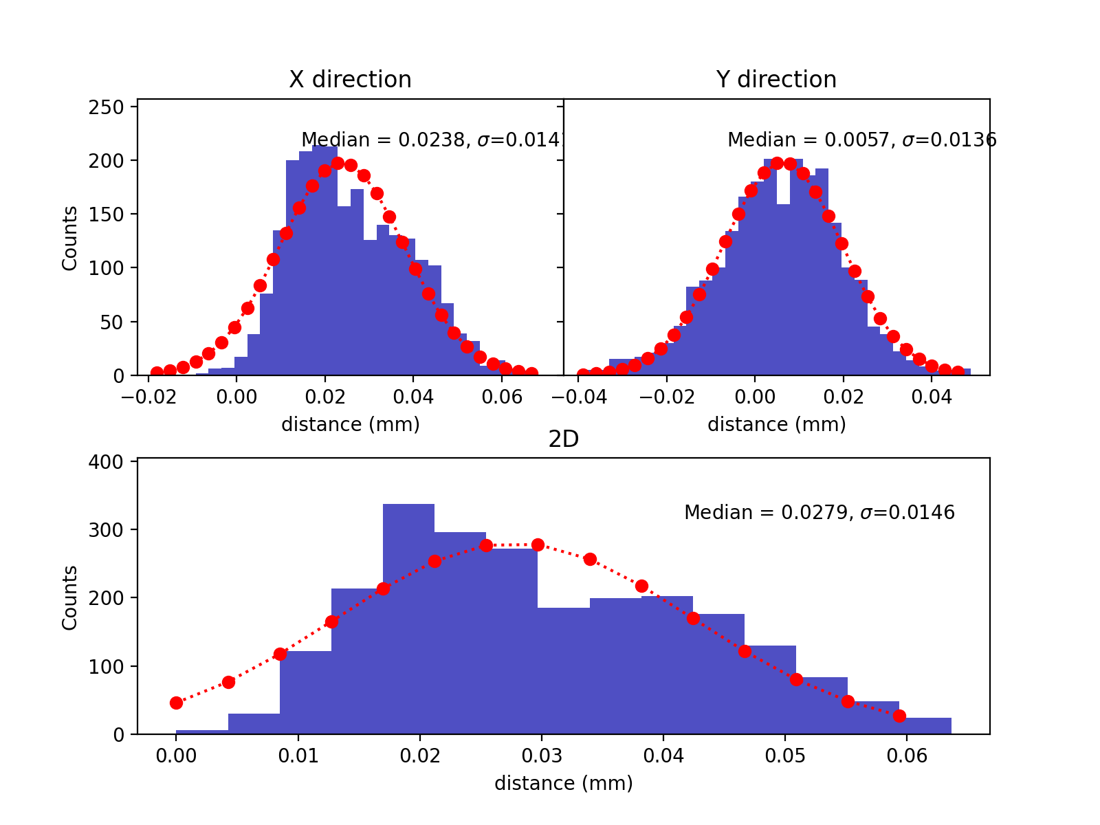
EL60-EL90

Slide 16
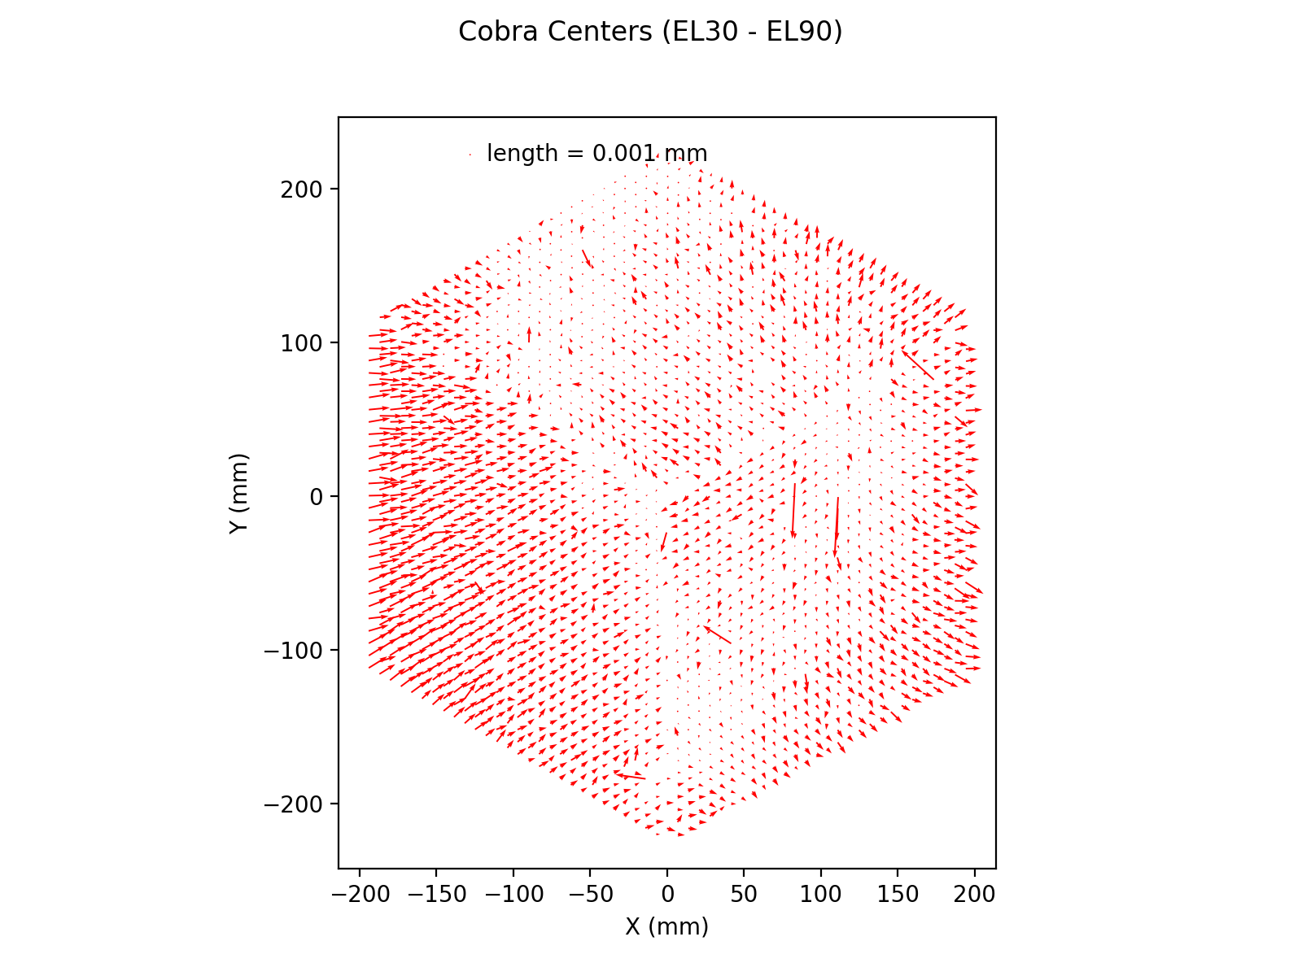
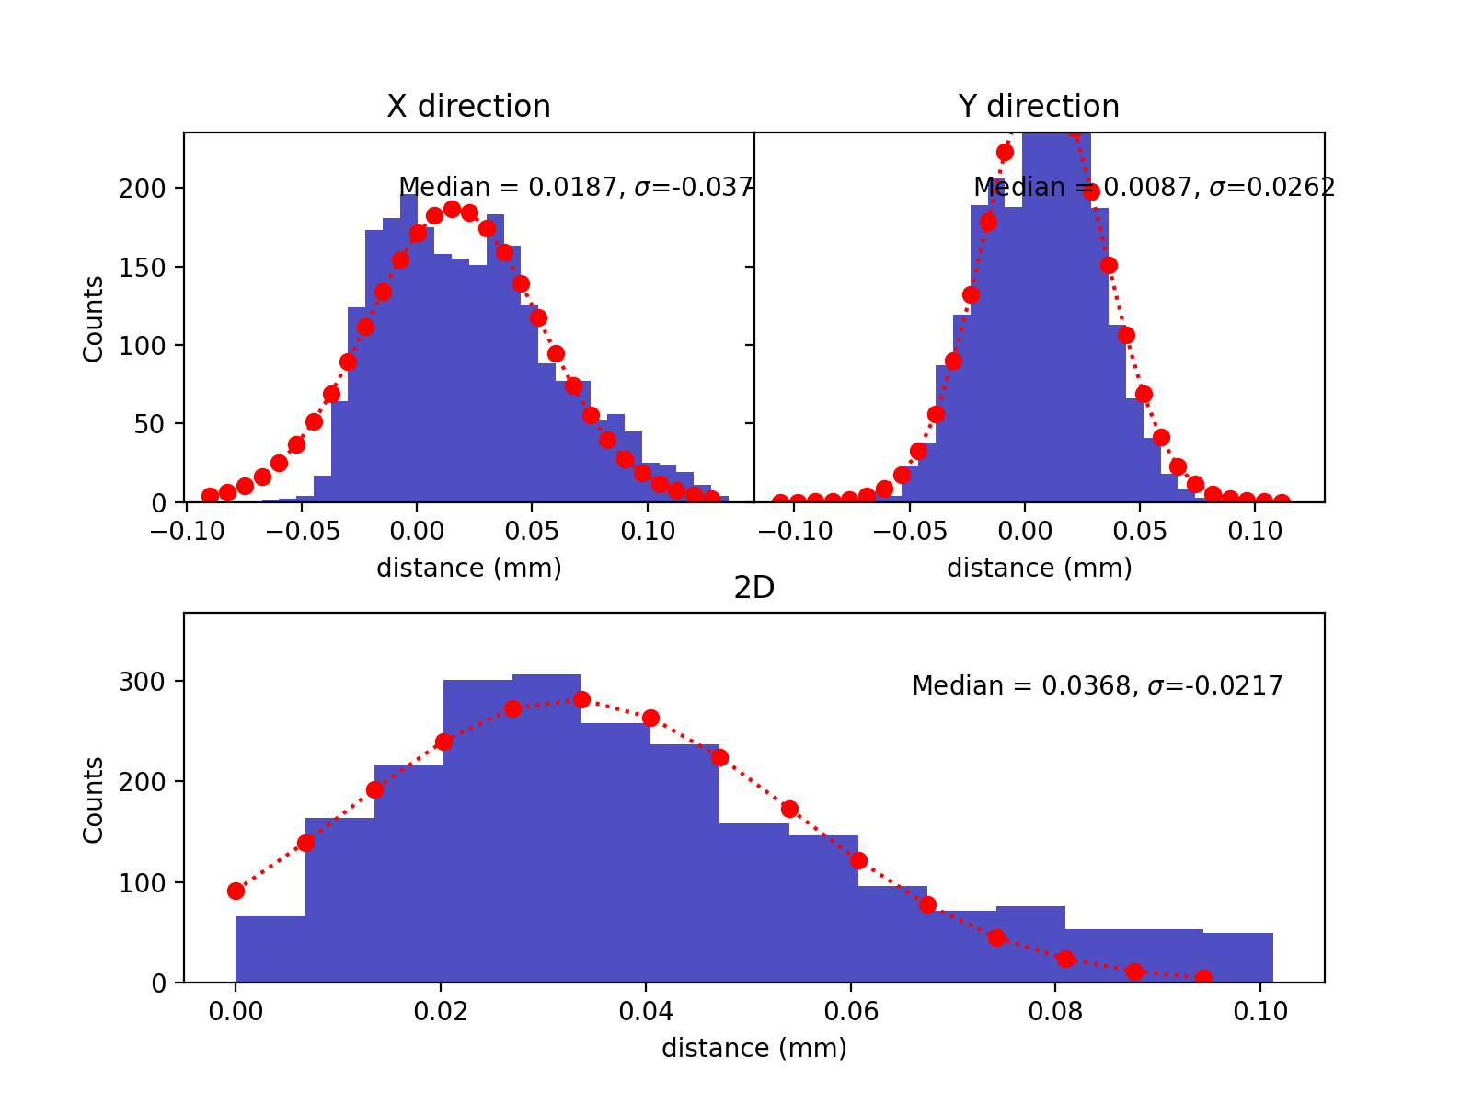
EL30-EL90

Slide 17
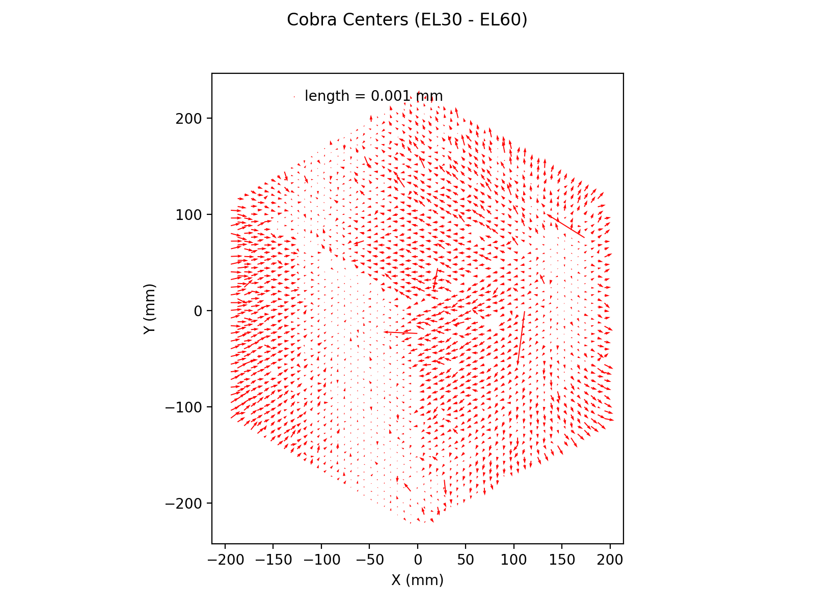
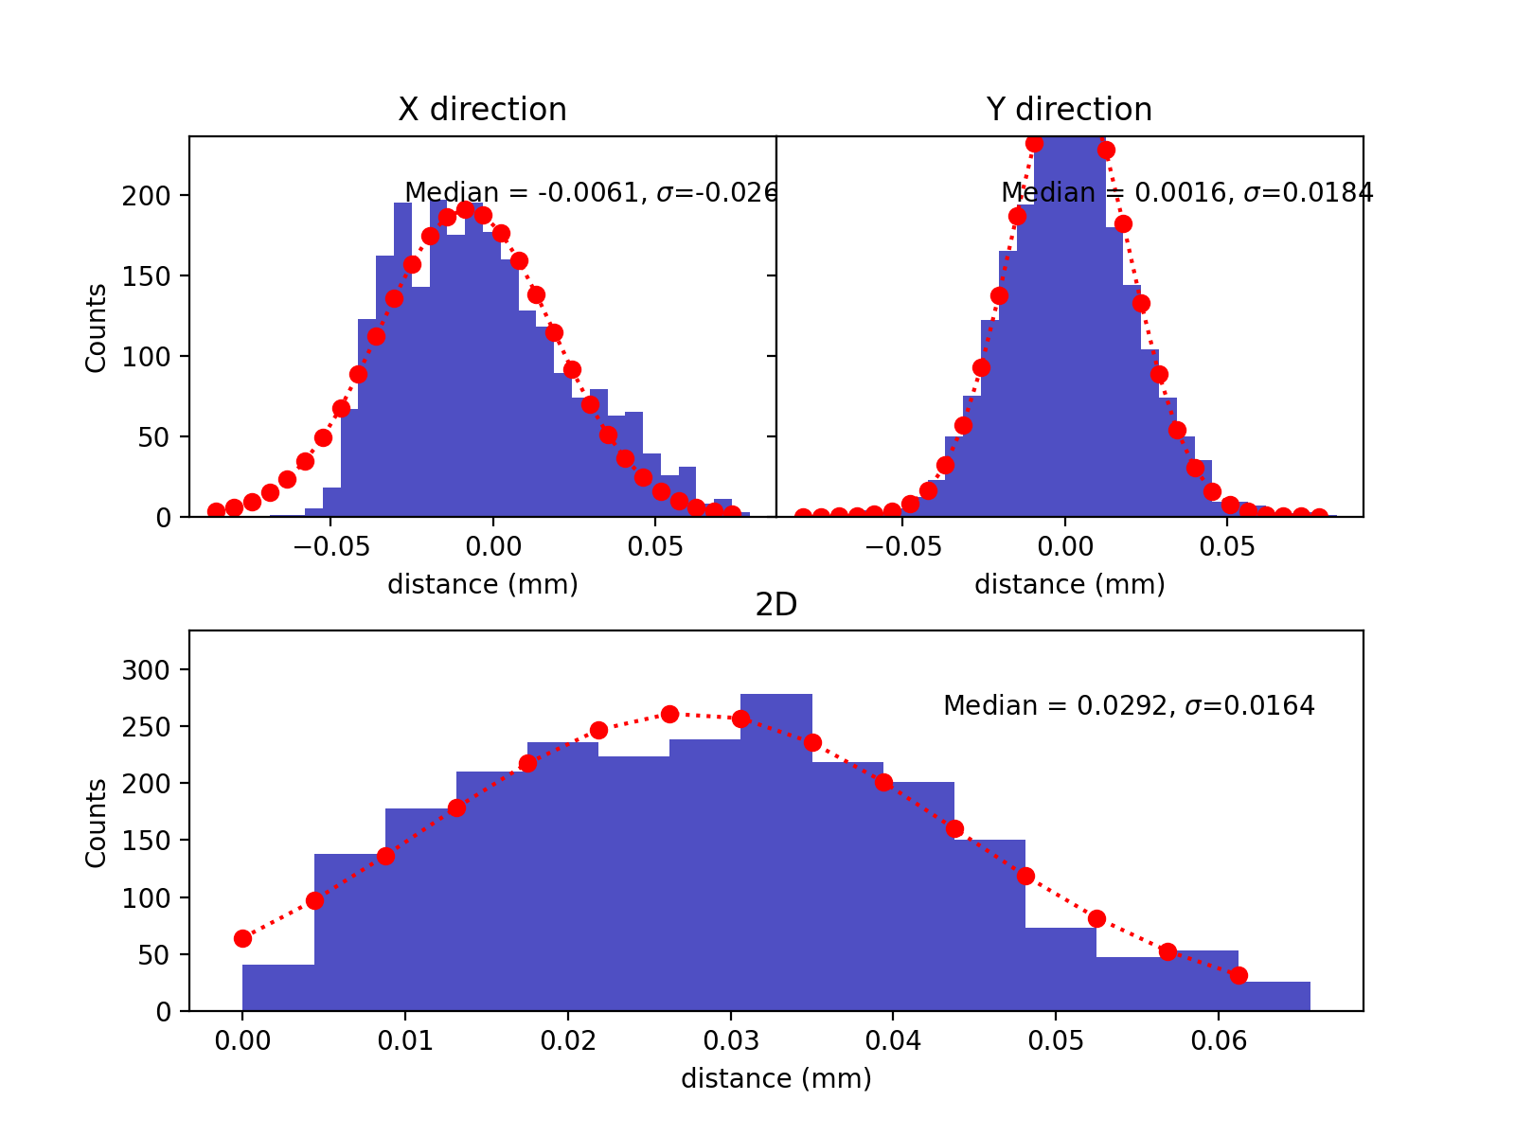
EL30-EL60

Slide 18
Cobra Armlength

Slide 19
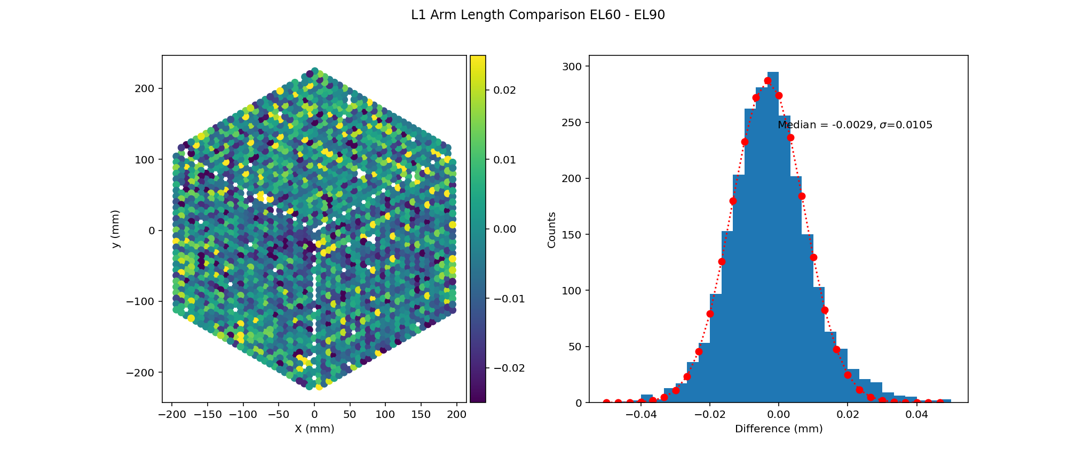
L1 (theta EL60-EL90)

Slide 20
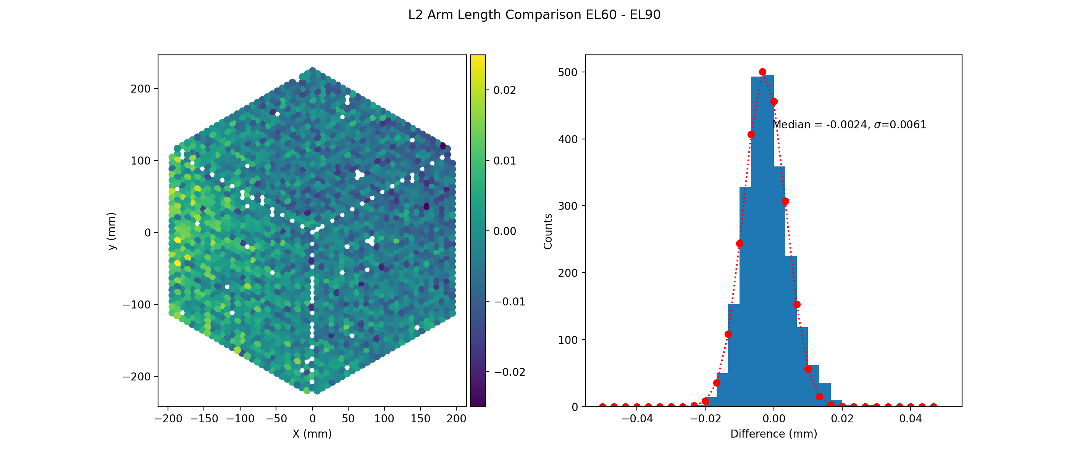
L2 (EL60-EL90)

Slide 21
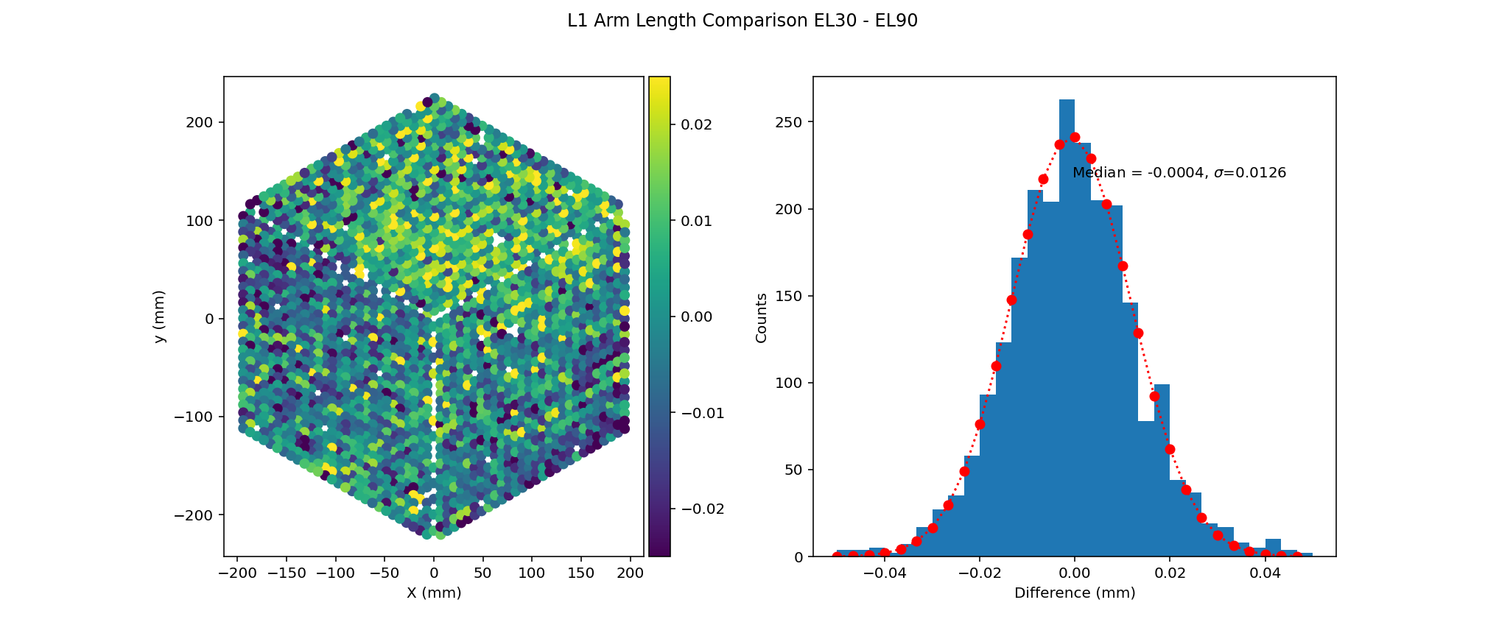
L1 (EL30-EL90)

Slide 22
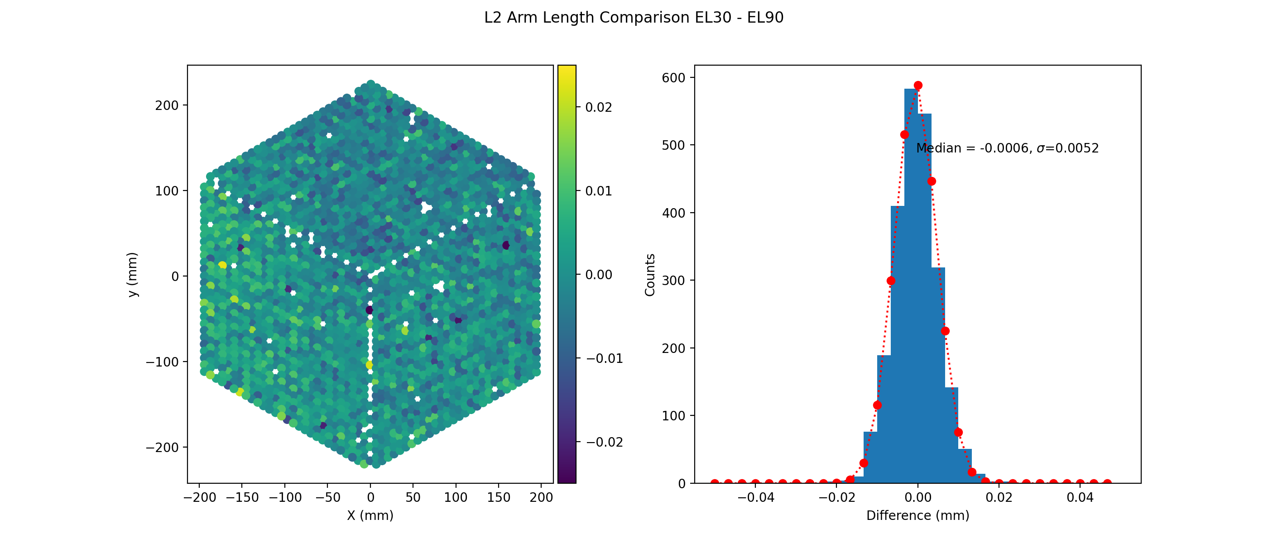
L2 (EL30-EL90)

Slide 23

L1 (EL30-EL60)

Slide 24
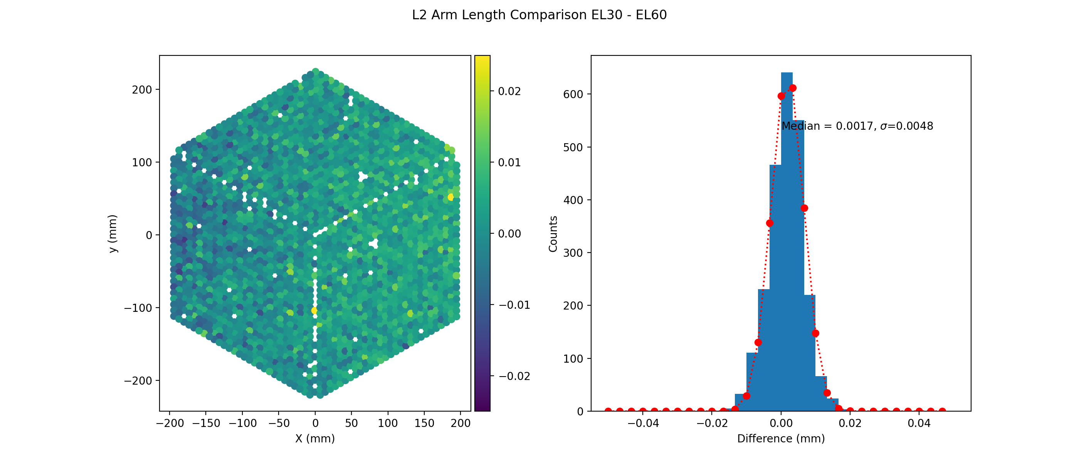
L2 (EL30-EL60)

Slide 25
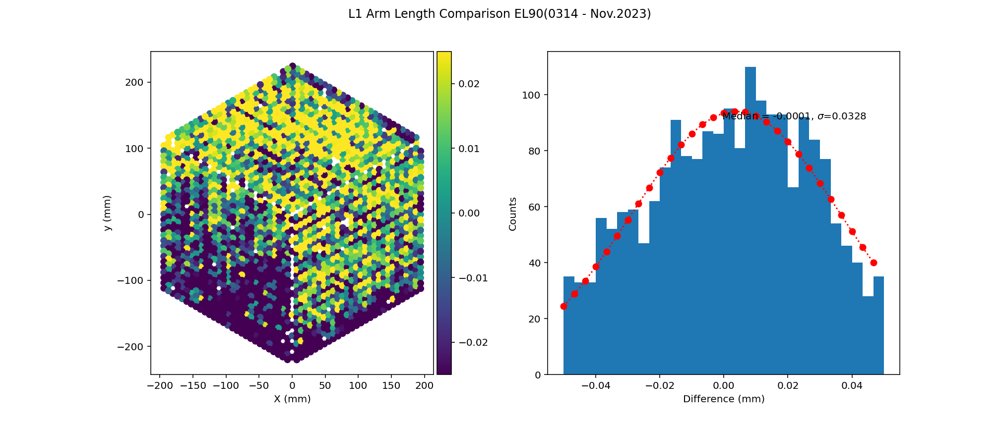
The difference between current and measured L1 arm lengths is getting bigger. We need to update the XML.

Slide 26
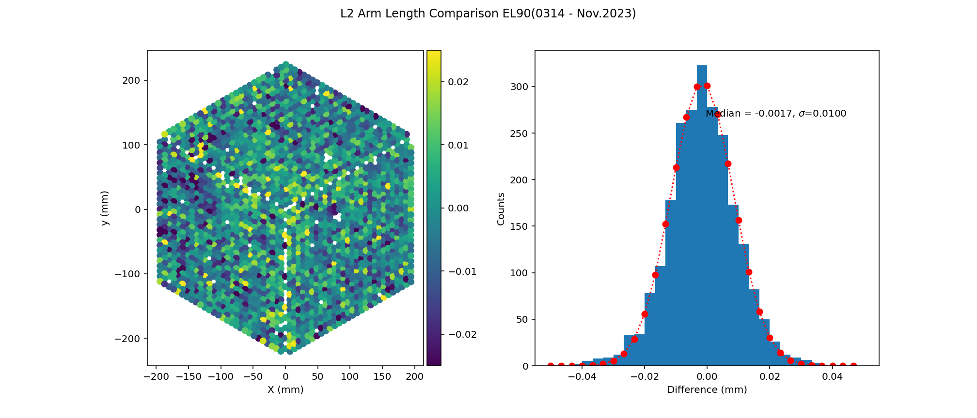

Slide 27
Bad Convergence Cobras

Slide 28
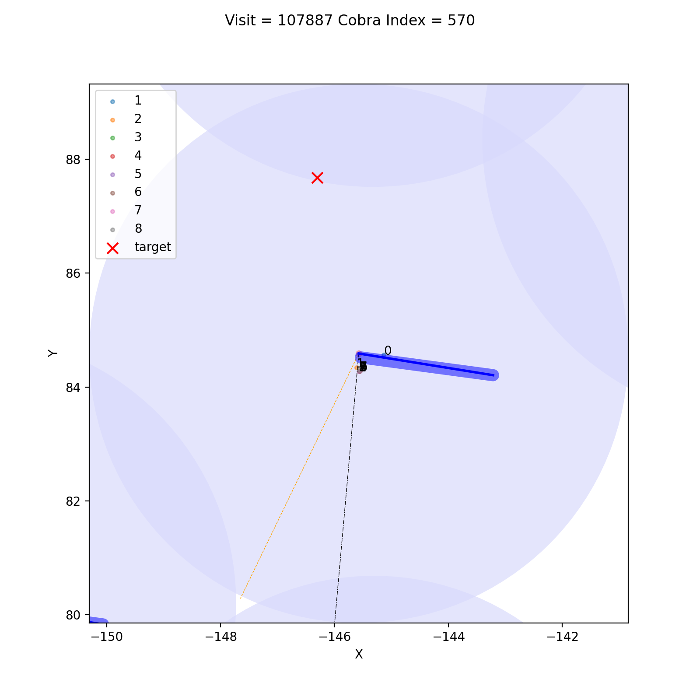
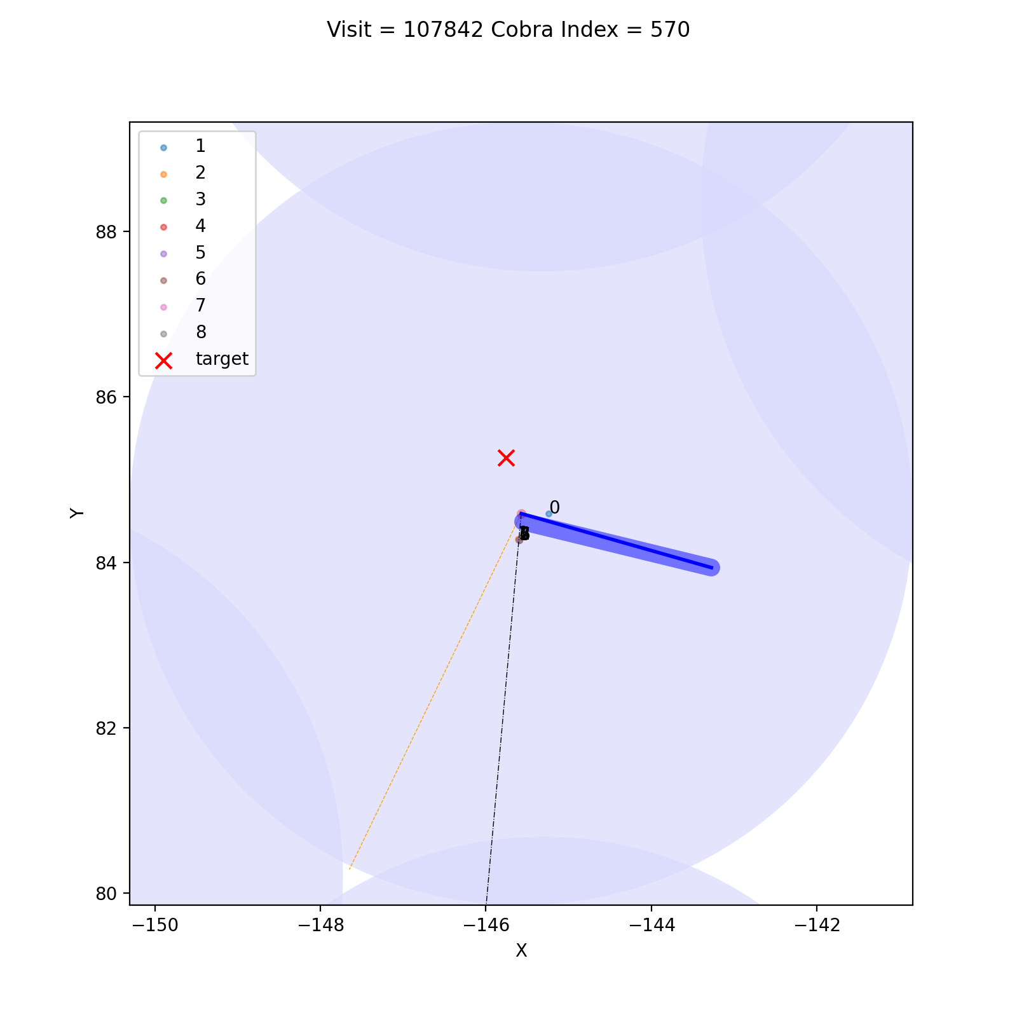
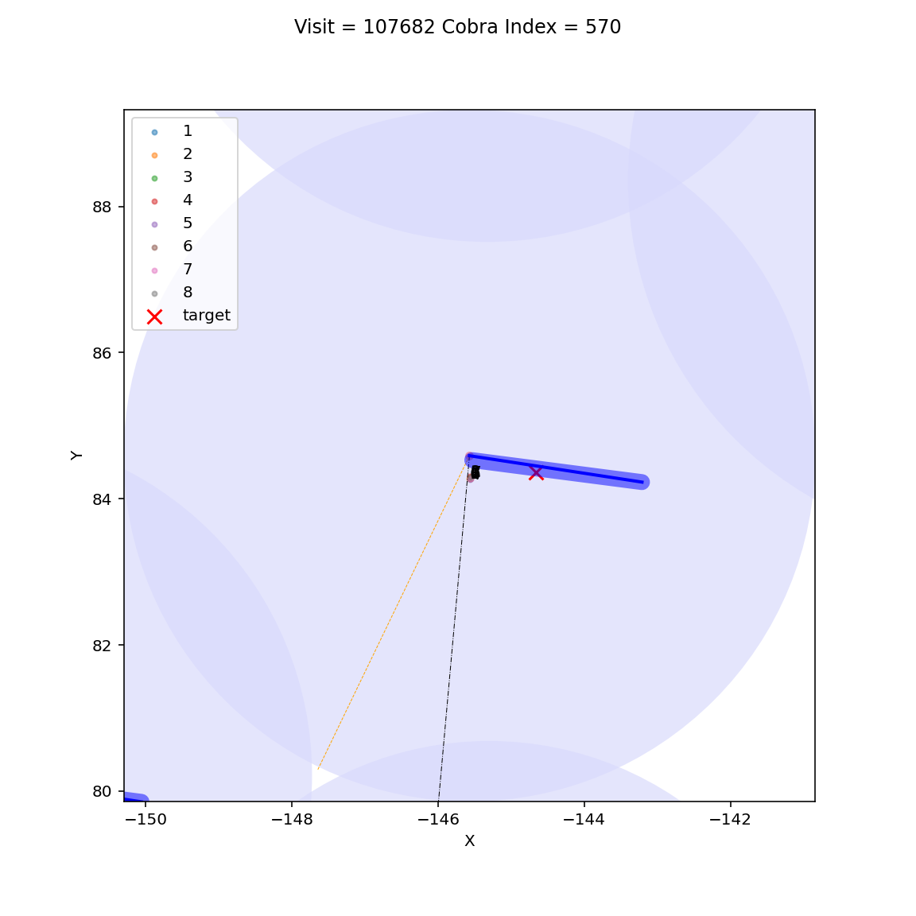
Among 110 convergence runs, only one cobra (cobra index = 570) repeatedly bad. This means the phi arm of this cobra is not opening due hardware issue.

Slide 29
Bad Cobra with Same Design

Slide 30
For studying the non-converged cobra, we checked the convergece runs with same design. Commanding cobra to the same design for 3 ~4 times, we can find out the cobras repeatedly bad.
We sent throught all cobra movement plots and identified serveral cases of non-convergence cobra.
  Bouncing: cobra is bounceing around the target. This is the majority of the convergence cobras (56.9%).
  Need Small Move: cobra is close to target. Those cobras just need very small move to get on targets (seeing? 16.7%).
  Sticky: the phi or theta arm is hardly moving. We have identify phi arm of cobra 570 is hardly open acrsso all designs (5.6%).
  Fiber ID confusion: ~(20.8%)

Slide 31
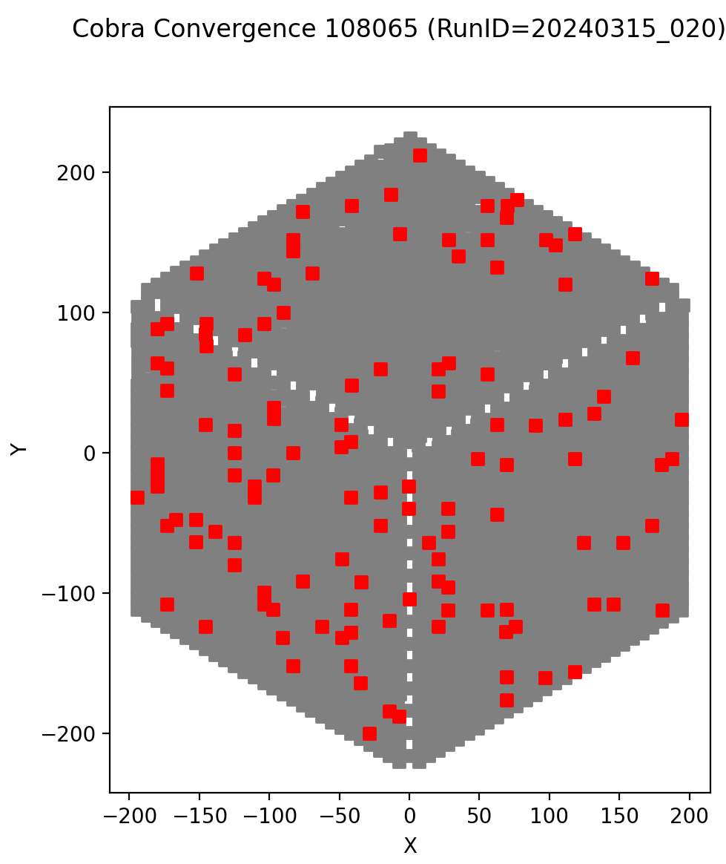
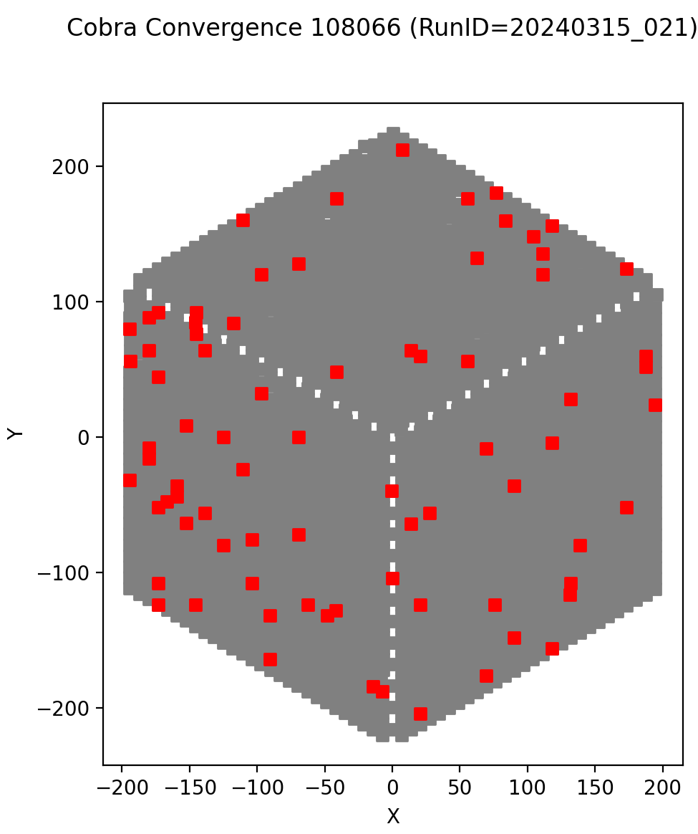
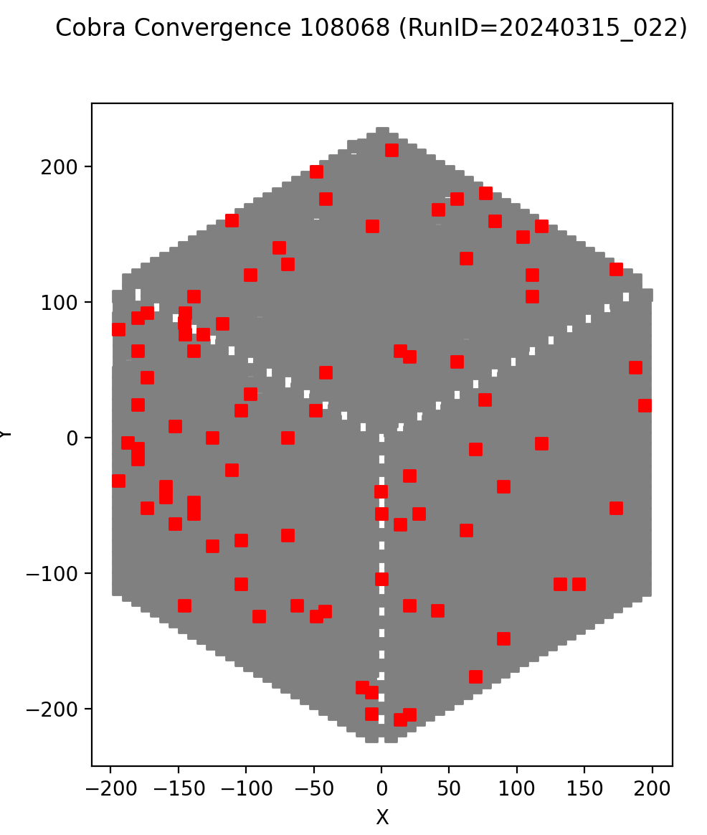
On March 15, we took several convergence runs with same design. This is for study the repeatibility of the “not done” (distance > 100 um) cobra.

Slide 32
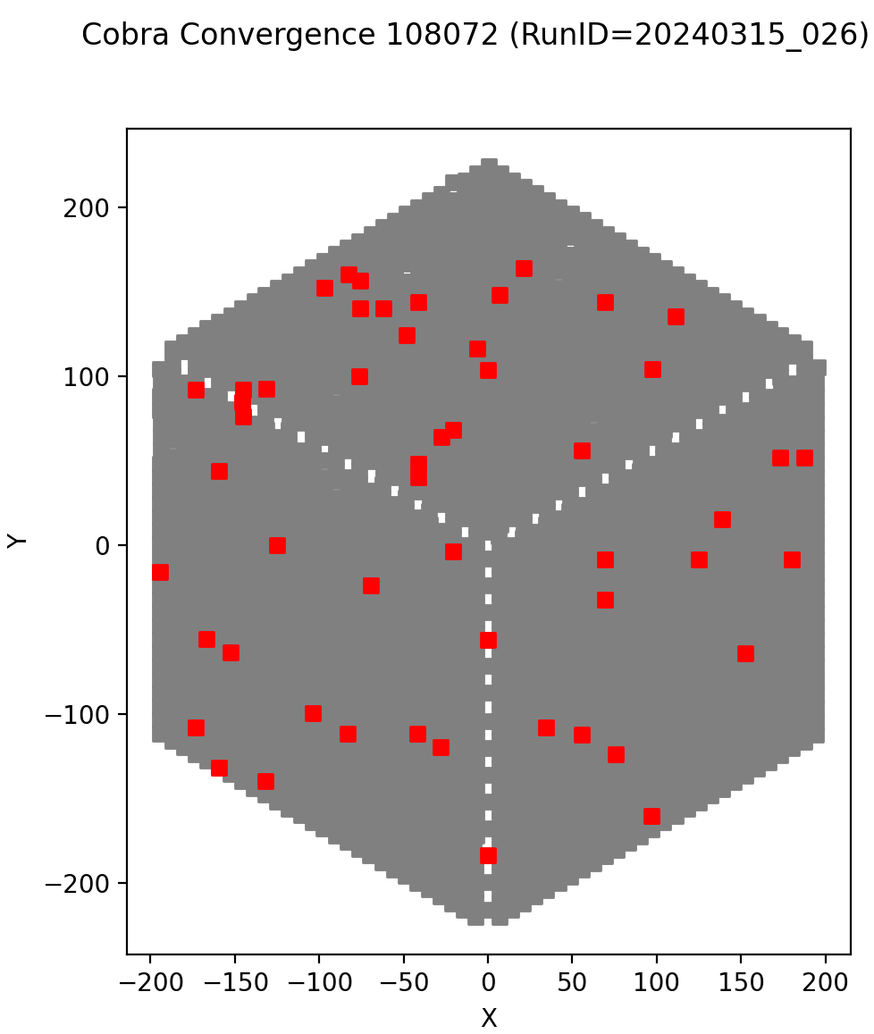
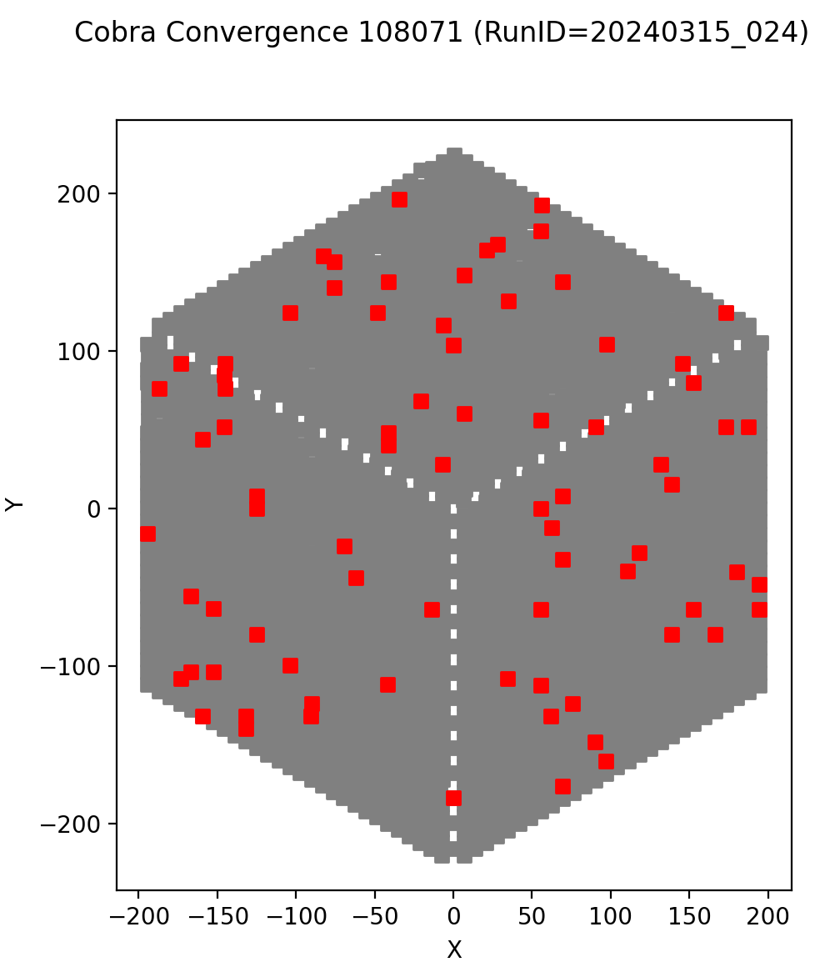
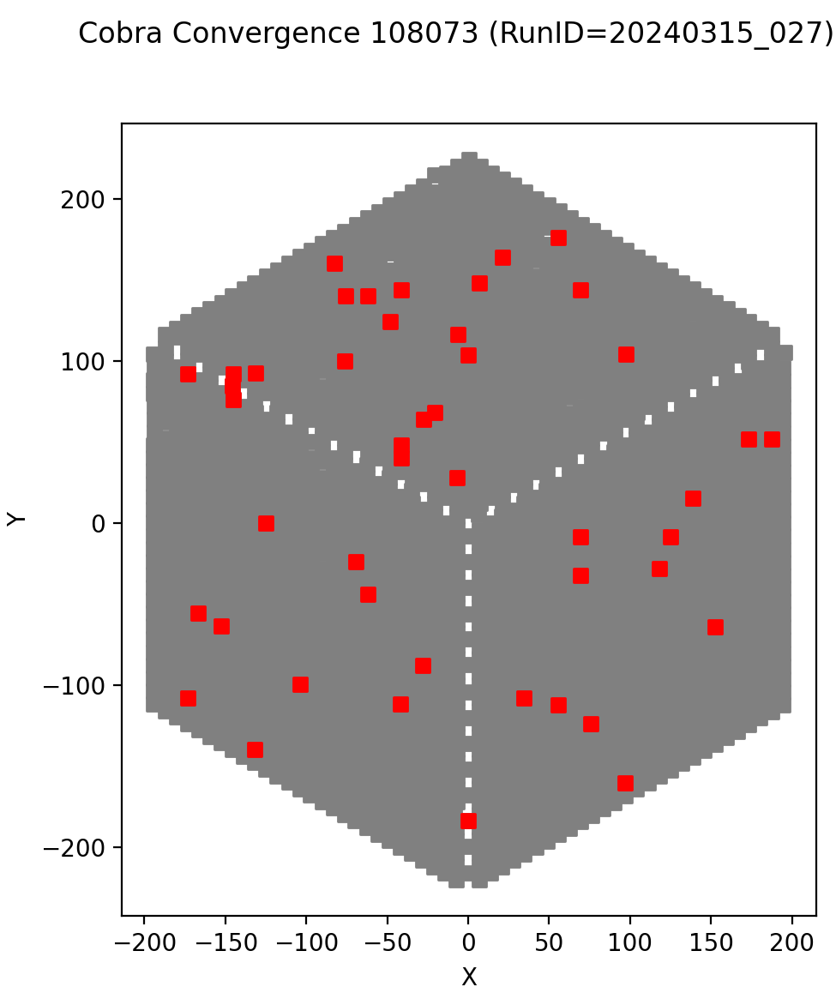

Slide 33
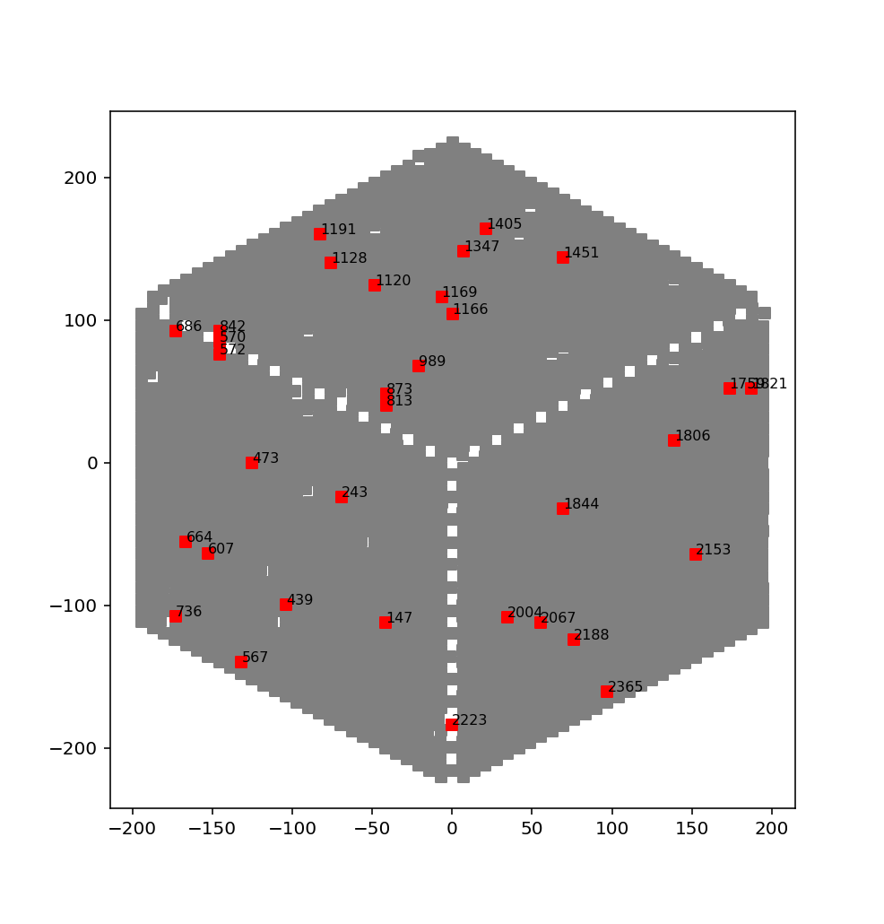
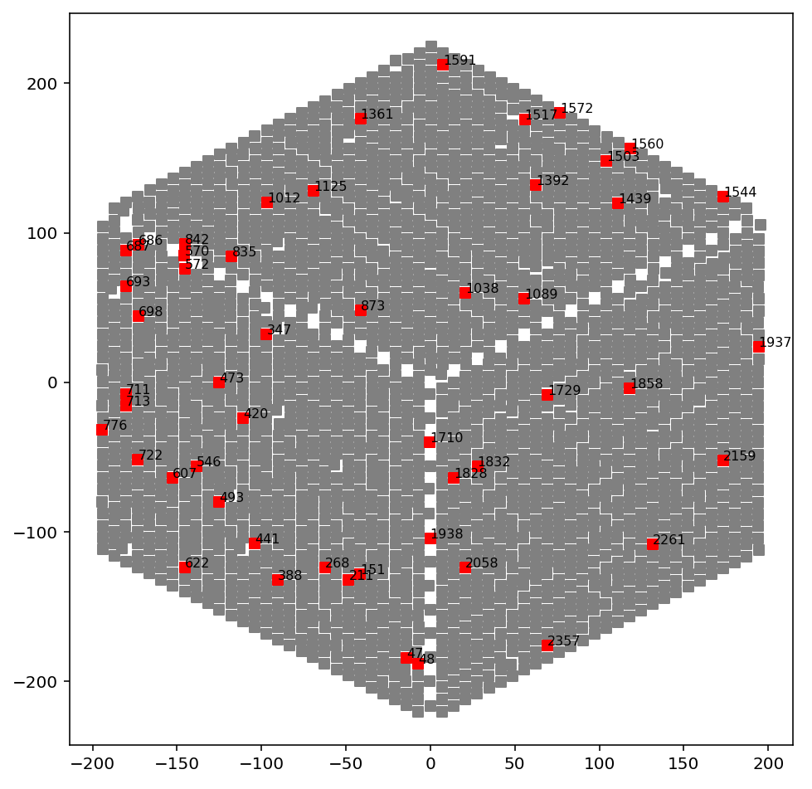
Repeatedly Bad Cobra of 108065, 108066, 108068
Repeatedly Bad Cobra of 108070, 108071, 108072, 108073

Slide 34
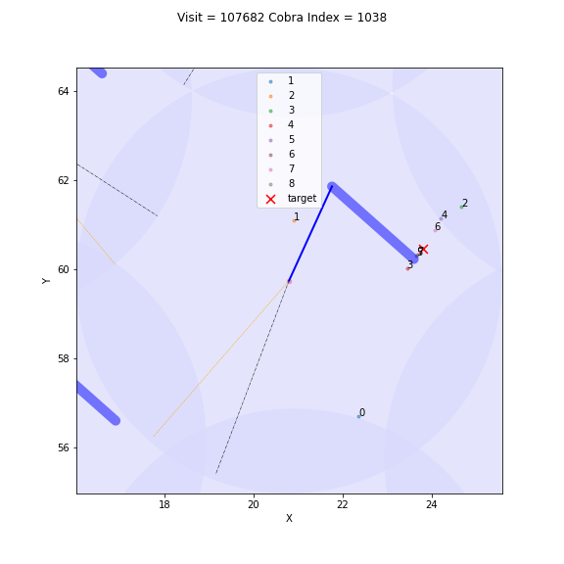
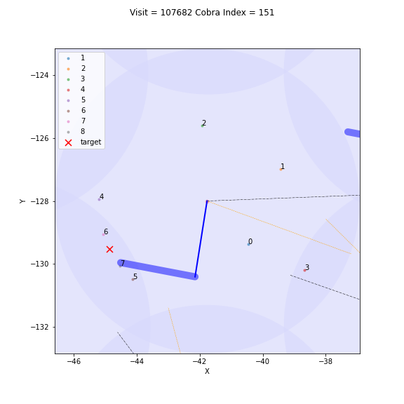
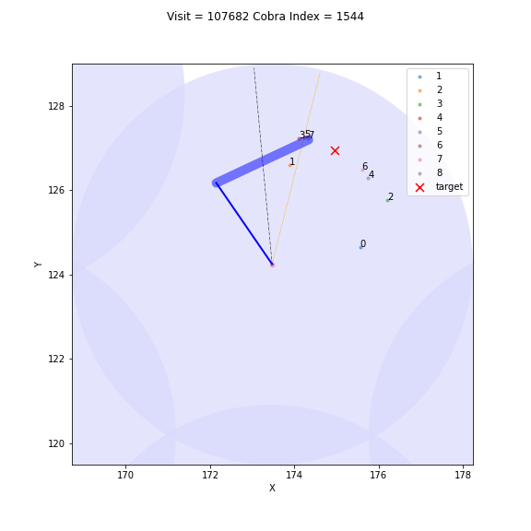
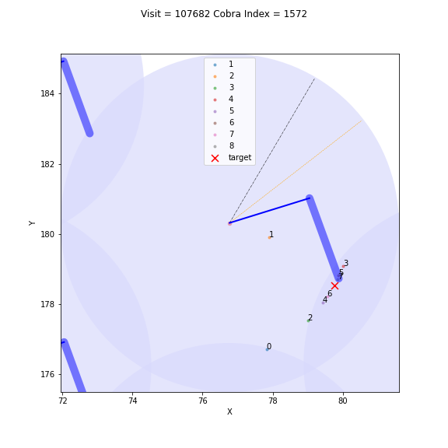
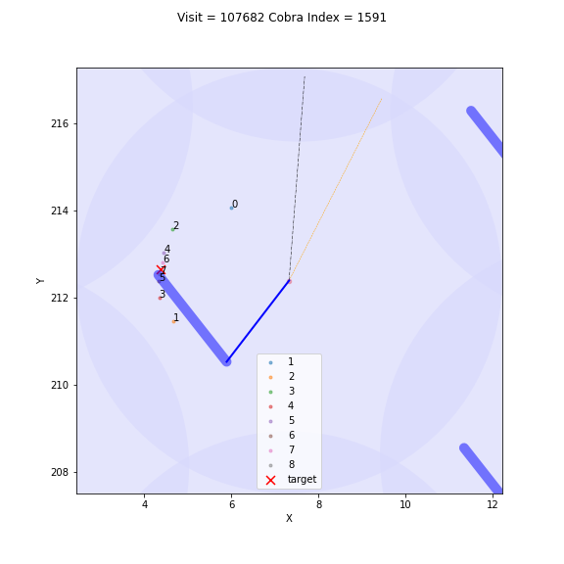
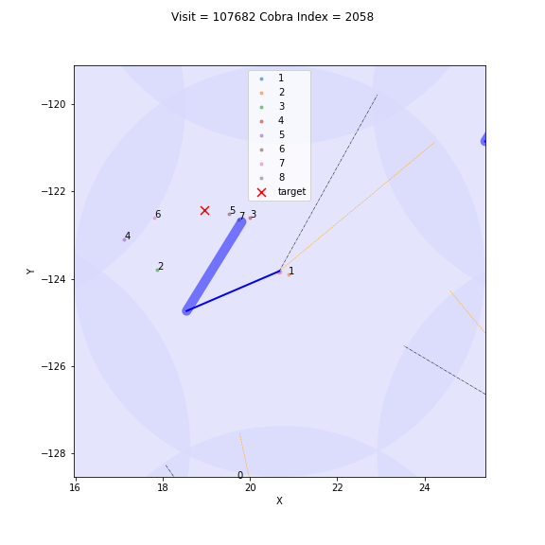
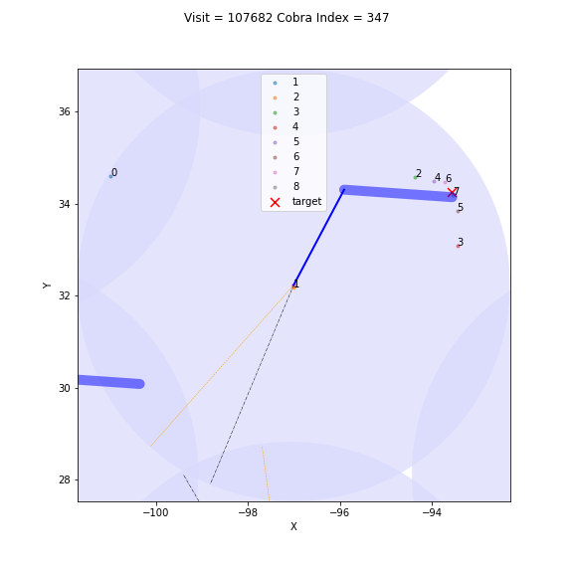
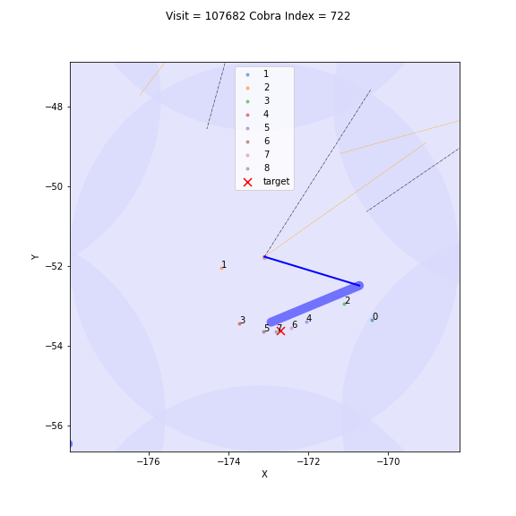
Bouncing

Slide 35



Need small move

Slide 36


Sticky
Note: Cobra 570 is identified as no phi movement in previsous analysis

Slide 37






Fiber ID Confusion

Slide 38
Operation Time

Slide 39


This is the FPS and MCS operation time in the 2023 December engineering run.

Slide 40


The MCS operation time is incresed because we turn off the threading function in centroid code. We need to test the centroid code more.

